Slide 1
Artificial Intelligence (AI)
Name of the maker: ashish

Slide 2
Table of Contents
1. Introduction to AI
2. Types of AI
3. Applications of AI
4. Challenges in AI
5. Future of AI
6. Summary

Slide 3

Introduction to AI
- Definition of AI
- Brief history of AI
- Importance and impact of AI in various industries

Slide 4
Types of AI
- Narrow AI vs. General AI
- Machine Learning
- Deep Learning
- Natural Language Processing
- Computer Vision

Slide 5

Applications of AI
- Healthcare
- Finance
- Transportation
- E-commerce
- Customer Service
- Manufacturing
- Education

Slide 6
Challenges in AI
- Ethical concerns
- Data privacy and security
- Bias in AI algorithms
- Job displacement
- Lack of transparency

Slide 7
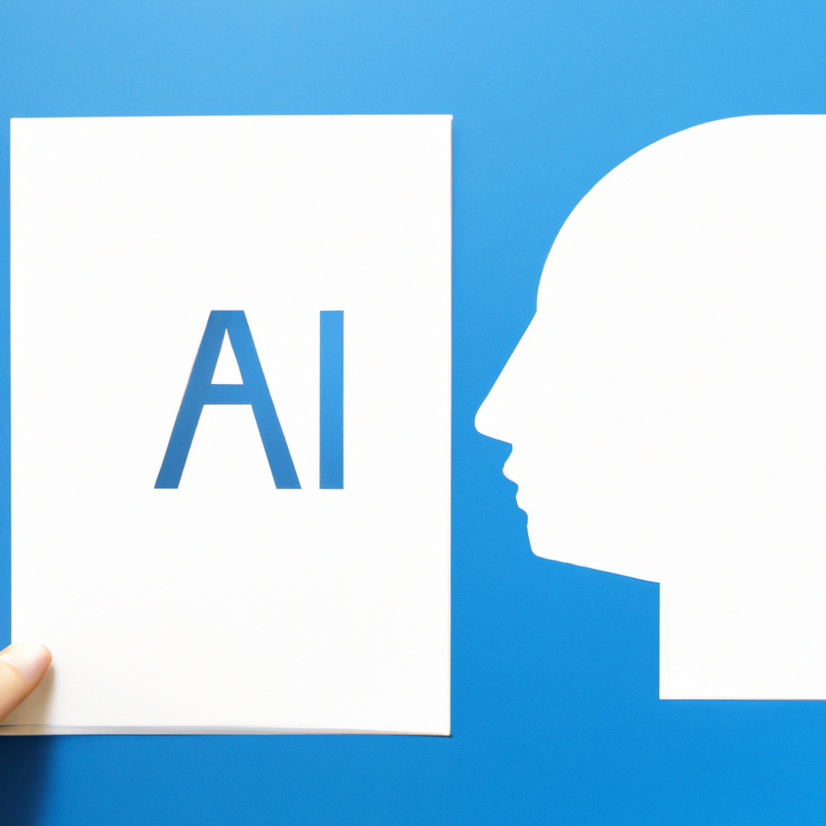
Future of AI
- Advancements in AI technology
- Integration of AI with other emerging technologies (e.g., IoT, robotics)
- Potential impact on society and economy
- Opportunities and challenges for further development

Slide 8
Summary
- Recap of key points discussed
- Importance of AI in various industries
- Potential benefits and challenges in the future

